Slide 1


Decoding Annual Reports
Reading between the lines: How to inspect a company's yearly prospectus like a professional analyst.

Slide 2
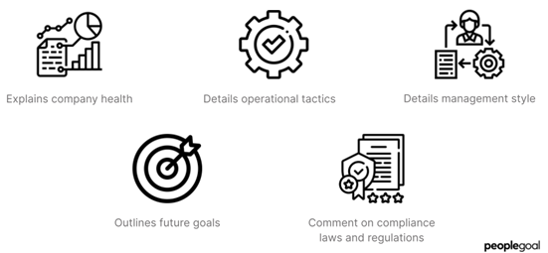
The Visionary View: Management Discussion (MD&A)
The Management Discussion & Analysis (MD&A) is written directly by the top executives and managing directors of the firm.
It reviews the macroeconomic environment, industry trends, and company performance over the past financial year.
It outlines future strategic goals, expansion plans, and capital expenditure targets.
Pro Tip: Compare what management promised last year in this section against what actually happened today to test their credibility!

Slide 3


The Independent Truth: Auditor's Report
The Watchdog's Verdict
Qualified or Adverse Opinions
The Auditor's Report is prepared by an independent external Chartered Accountant firm hired to scrutinize every financial ledger of the company.
Qualified Opinion: The auditor found discrepancies or areas they could not verify fully. Proceed with caution.
Adverse Opinion: Major fraud, misrepresentation, or severe non-compliance detected. Run away immediately!
Unqualified (Clean) Opinion: The financial statements are accurate, fair, and adhere strictly to accounting standards.

Slide 4

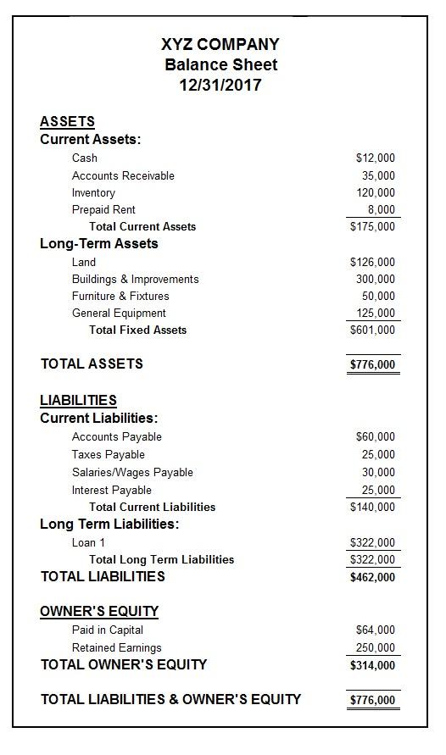
The Fine Print:
Notes to Accounts
Amateurs look only at the P&L and Balance Sheet numbers. Professional investors spend 80% of their time reading the Notes to Accounts.
What's inside: Detailed breakdowns of accounting policies, contingent liabilities (lawsuits or tax disputes that could blow up unexpectedly), and related-party transactions.
This is where promoters try to hide aggressive accounting tricks or complex loans given to sister companies.

Slide 5
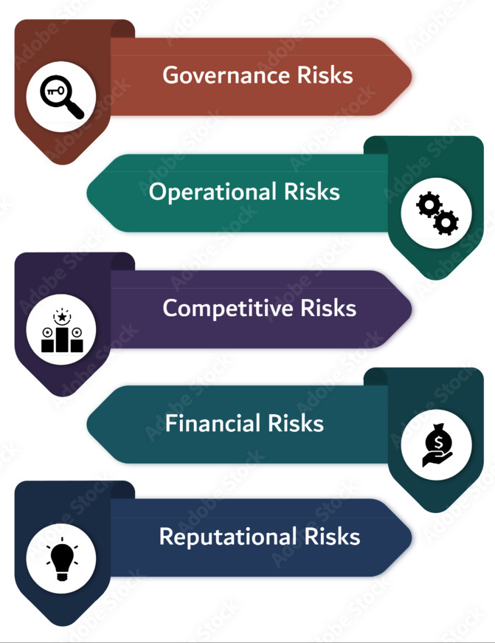
The Dark Side: Risk Factors
Anticipating the Storm
Every legitimate annual report contains a dedicated section detailing the specific business risks facing the company.
Regulatory Risks: Government policy changes or heavy taxation.
Operational Risks: Raw material price volatility or customer concentration (reliance on top 2-3 clients).
Currency & Geopolitical Risks: Forex fluctuations and global supply chain disruptions.
Evaluating these risks tells you whether management is realistic or overly optimistic.

Slide 6
Great Job on Day 14!
Tomorrow: Company Analysis.
Don't forget to Like, Share, and Subscribe!
/ @EarnJoyOfficial

